Slide 1

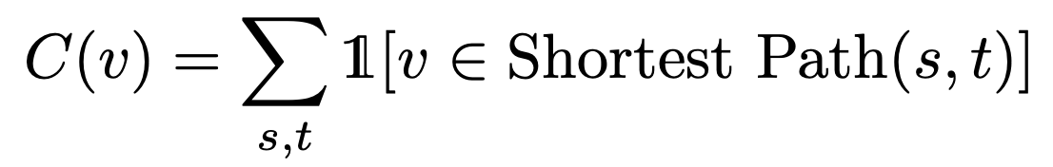
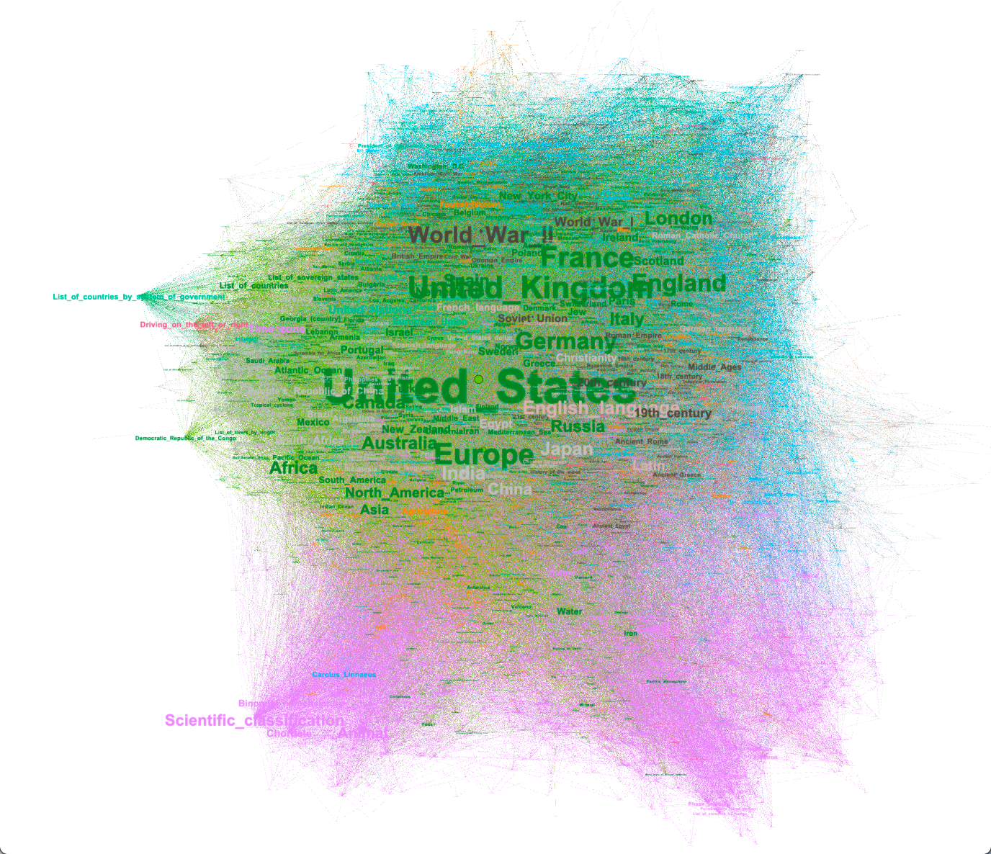
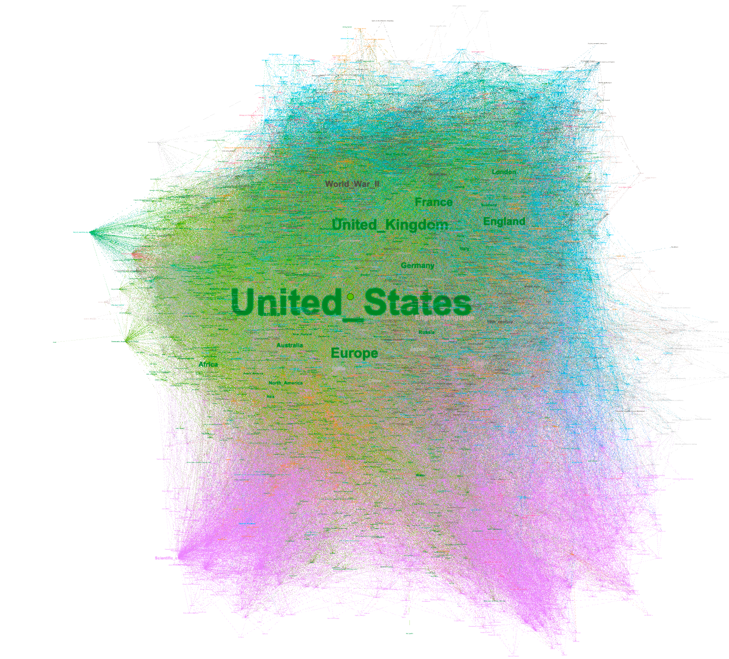
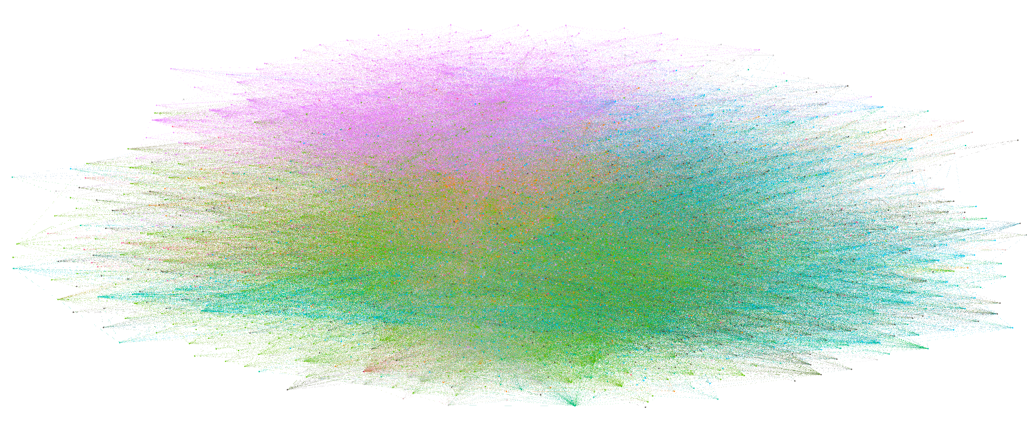
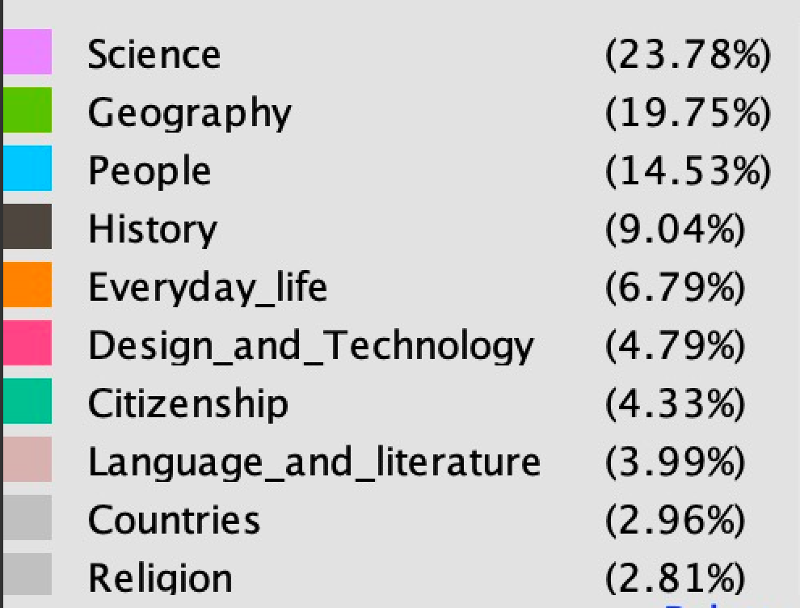
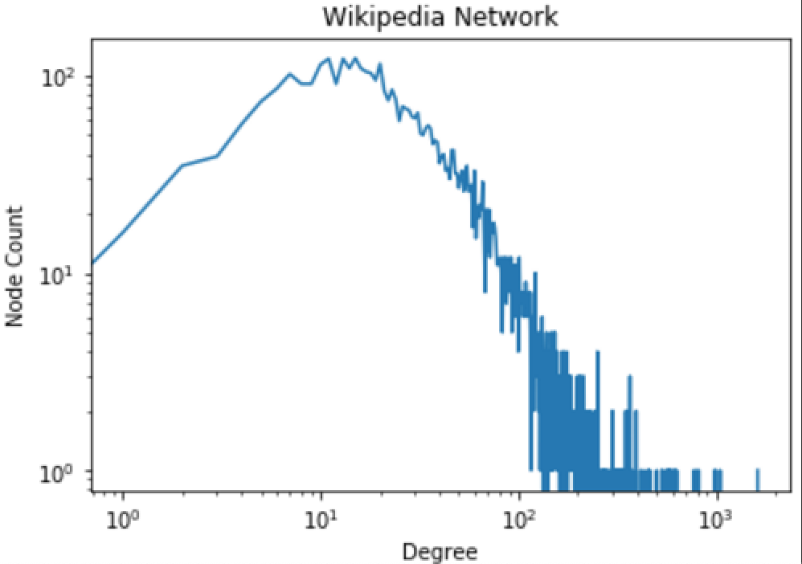
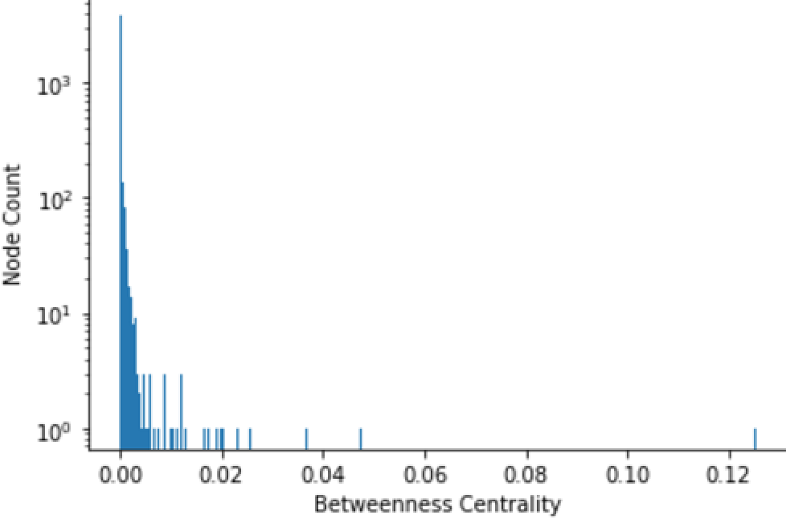
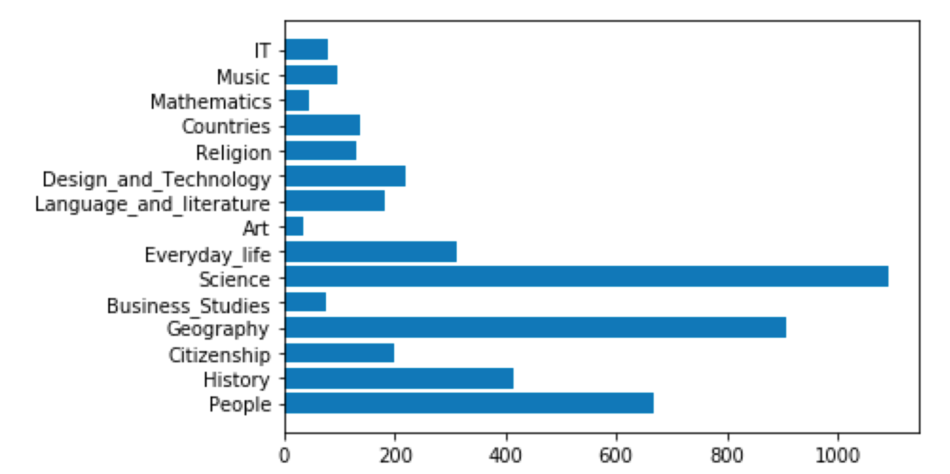
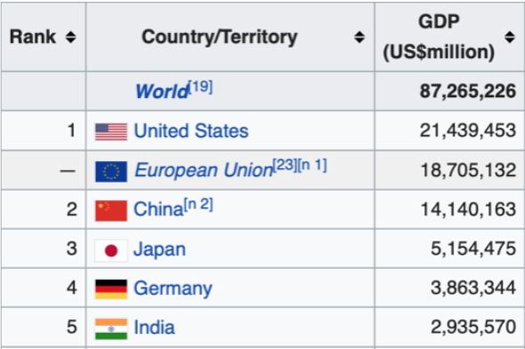
Wikipedia Links Network Analysis
Haoyuan Cao, Kalvin Goode, Hongquan Zhang, Jialu Zhao
ECE 227 Big Network Data
Objective
Results
Discussion
Wikipedia is one of the largest online encyclopedia and there are more than 5,000,000 articles in English. Wikipedia’s articles also provide links for users with related pages and additional information. Wikipedia has a large network containing numerous links. We want to investigate the most important articles with multiple methods in this Wikipedia network, and why they are important to human society.
Degree distribution
From Figure 1. and Figure 2., we found those about degree distribution:
Most nodes(links) have degree 10.
The largest degree is about 1000.
Country-related articles tends to have high degrees.
Articles are likely to mention United States, European countries, and World_War_II.
Links with physical meaning, some of them also have large degrees like water, earth, gold, currency, sun, human and plant. There are some common feature for all of them:
Refer to a large kind
More or less contain political meaning
About the most basic survival (sun and water produce plant, plant produces animals, human eat plant, animals and water)
Betweenness Centrality
From Figure 3. and Figure 4, we found those about betweenness centrality:
(1) Most labels are about countries or areas.
(2) United_States has the largest Betweenness Centrality.
(3) Most nodes’ Betweenness Centrality is from 0 to 0.02.
Category
Every link in Wiki has its own category, we calculate the number of links in different categories and show it in Figure 5. and Figure 6..
(1) Science has the most amount of Wiki links/articles.
(2) Art has the least amount of Wiki links/ articles.
A.Degree distribution
Political topics or problems have a dominant position compared with others like natural resources or animals topics. The world is under the influence of world war II.
Most nodes have only 10 degrees which is relatively low, it’s because they are not related to critical or popular topics like politics and nature, or they are too new to have connections with others. For example, links about computers won’t be absent in this network because all of us know the importance of it. But compared with politics and the world rules built after world war II, computer is more like an infant.
Another explanation is that most nodes tend to maintain themselves if a node is related to a relatively physical stuff. Let’s say among nodes with 10 degrees, a node may have a label ‘cloths’. Obviously, ‘cloths’ has its own history, at least longer than the history of the US, so it can be have a great number of connections with others but the fact is it has only 10 connections.For example, ‘cloths’ can be connected with other links with physical meaning like ‘shirt’, or with abstract meaning like ‘art’, the problem is the number of nodes with physical meaning is small due to its narrow fields, and for a link with physical meaning, you may set one or two attributes to it, like art to clothes, but it’s hard to set more attributes( you won’t say ‘clothes’ will have a connection with business analysis).
For community: Basically, there are three factors determining communities, history, geography and type. European countries tend to group together; Japan, Spanish language are grouped with the US; Sun, Gold, and other tab with physical meaning are grouped.
B. Betweenness Centrality
A node with a high Betweenness Centrality is a critical one to preserve the stability of the whole network. Specifically, in terms of country labels, a country with high high Betweenness Centrality tends to play an important role in the world. That is to say, this country tends to make more contribution to the world development because the development of other countries or areas are based on this countries. A simple explanation is to combine with GDP tables as Figure 7.. Obviously, countries with high high Betweenness Centrality have high GDP, and high GDP can reflect the extent of distribution.
C. Category
From previous analysis, we know that the United States is the most important link no matter from degree or betweenness centrality. By checking different links’ categories, we found that most links are related to science. This might be because of that the united states or some big important countries put more efforts on Science and there are more job opportunities related to science. On the other hand, compared to science, art has less articles. This can also be caused by that the United States or other big counties in the world didn’t pay a lot of attention to art. There are fewer job opportunities about art.
Theory
There are two important network analysis methods that can be used in this wiki network analysis::
(1) Degree distribution.
Degree of a node in a network is the number of connections it has with other nodes. Degree distribution is the distribution of every node’s degree in the whole network.
(2) Betweenness Centrality.
The number of times that a node is in other two nodes’ shortest path.
A node is more important if it must be used more often in communication among all other pairs of nodes.
Conclusions
Figure 1. Wiki Network Visualization by Degree
Figure 3. Wiki Network Visualization by Betweenness Centrality
Figure 5. Wiki Links Category Visualization
Figure 2. Wiki Network Degree Distribution
Figure 4. Wiki Network Betweenness Centrality
Figure 6. Wiki Links Category Bar Chart
Figure 7. 2019 estimates GDP Table
Contact
References
[name]
[organization]
[address]
[email]
[phone]
1.Centrality. (2019, September 15). Retrieved from https://en.wikipedia.org/wiki/Centrality.
2.International Monetary Fund. (2019, November 26). Retrieved from https://en.wikipedia.org/wiki/International_Monetary_Fun

